Slide 1
Workshop 3 – Support Vector Machines
Advanced Analytics and Applications [AAA]
Information Systems for Sustainable Society (is3) | WiSo Faculty | Univ.-Prof. Dr. Wolfgang Ketter | 4/28/20

Slide 2
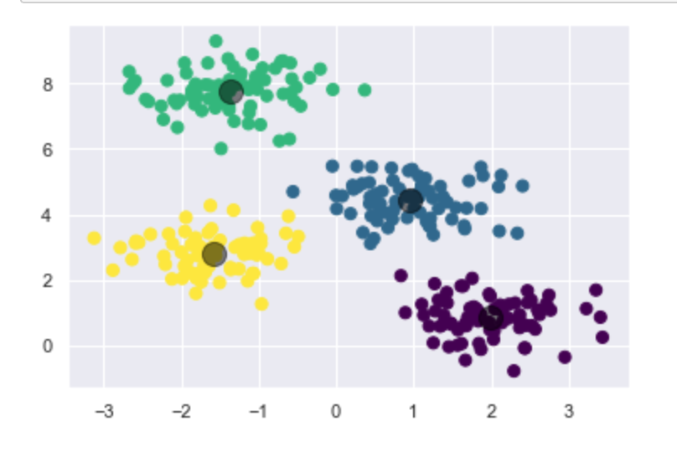
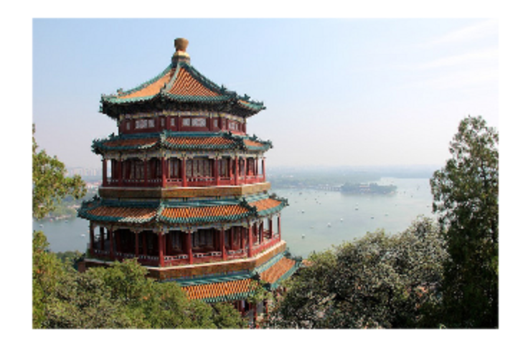
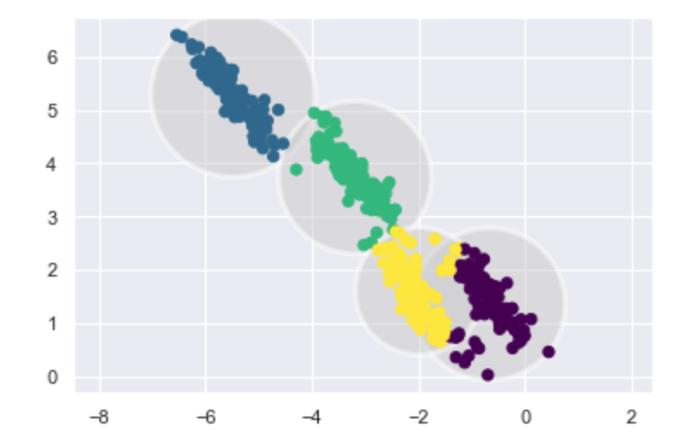
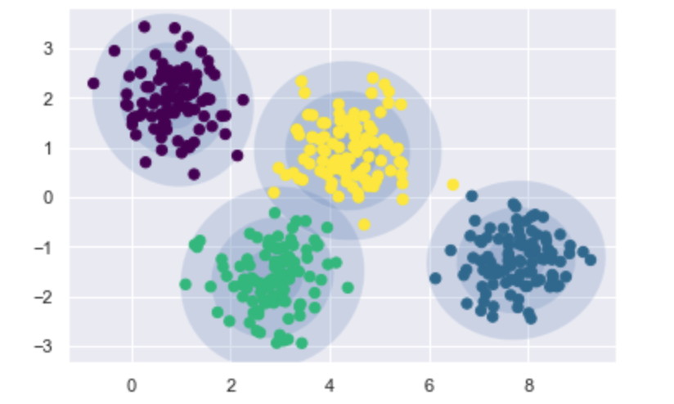
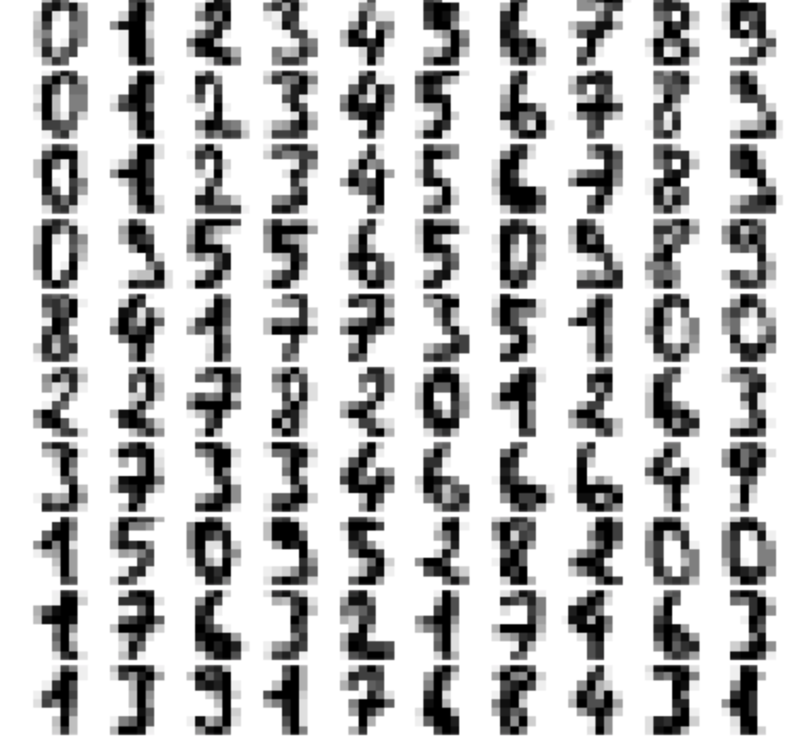
Outlook
Content
I
Hard-Clustering Revisited
II
Soft-Clustering with Gaussian Mixture Models

Slide 3
Outlook
Content: Visualizing clusters centers

Slide 4
Outlook
Content: Image compressing with hard clustering

Slide 5
Outlook
Content: What does „overlapping“ of clusters mean?

Slide 6
Outlook
Content: Gaussian Mixtures visualized

Slide 7
Outlook
Content: Using Gaussian Mixture models to construct kernels and sample „new“ data

Slide 8
Contact
For general questions and enquiries on research, teaching, job openings and new projects refer to our website at www.is3.uni-koeln.de
For specific enquiries regarding this course contact us by sending an email to the IS3 teaching address at is3-teaching@wiso.uni-koeln.de

